Slide 1
Structure Aware Negative Sampling in Knowledge Graphs

Slide 2
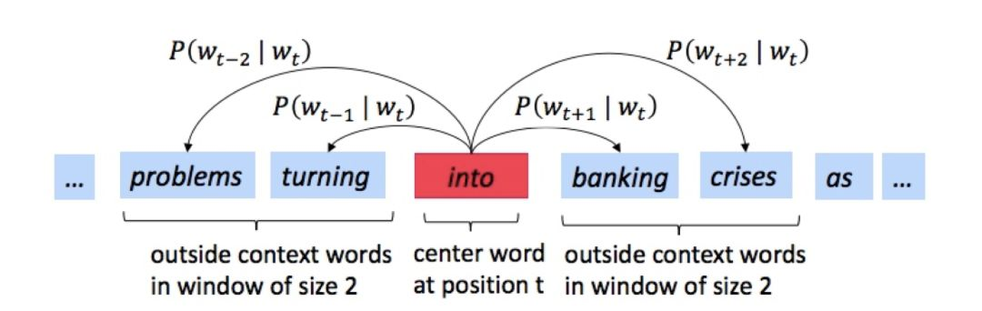
Negative Sample来源于Word2Vec
遍历整个语料库的所有单词
预测每个单词周围的单词（以一个特定的窗口大小），如下图的例子所示，窗口大小为2。

Slide 3
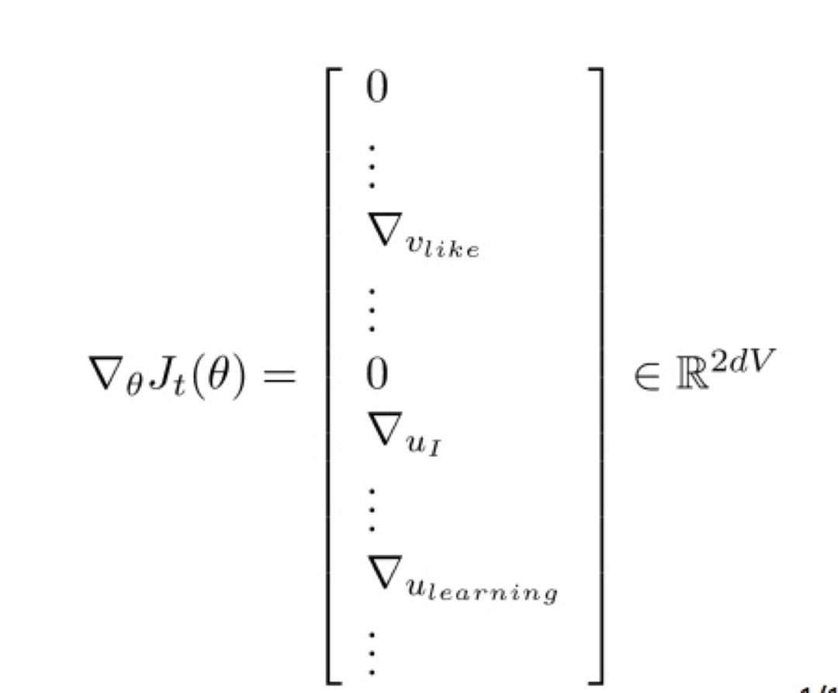
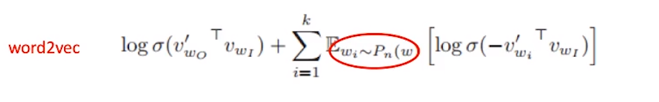
2. 带有词向量的随机梯度（Stochastic gradients with word vectors）
然后在每一个这样的窗口（window）计算梯度（take gradients）进行随机梯度下降（SGD）
梯度矩阵会非常稀疏（sparse）! 因为我们只更新那些实际上真正出现的单词。
简单定义分布函数为Uniform分布

Slide 4
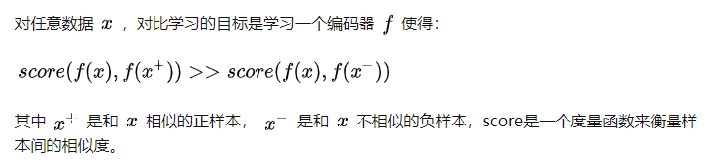

Contrastive Learning
论文中指出:对比学习关键步骤就是要选取出hard负样本，让Embedding模型学习到观测数据的重要特征。
A crucial aspect of contrastive learning approaches is the choice of corruption distribution that generates hard negative samples, which force the embedding model to learn discriminative representations and find critical characteristics of observed data.

Slide 5

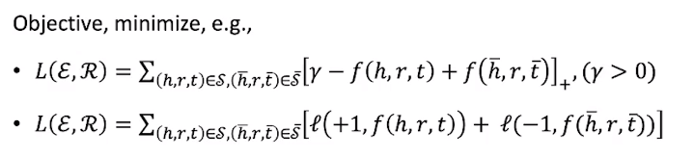
使用Contrastive Learning
1. contrastive learning approaches enjoy significant computational benefits over methods that require computing an exact softmax over a large candidate set, such as over all possible tail entities given a head and relation.
在做链路预测的时候，使用的预测函数。若缩小candidate量
Another important consideration is modeling needs, as certain assumptions are best expressed as some score or energy in margin-based or un-normalized probability models
减少了计算量

Slide 6
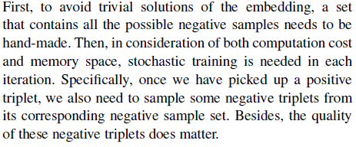
WHY Negative Sampling
A KG only contains observed facts(positive triplets)
Non-observed ones are assumed to be negative with large probability
负采样是选出high score function的non-observed，通过Contrastive Learning学习到样本真正能够区别的重要特征。
以便于以后的链路预测（个人理解）

Slide 7
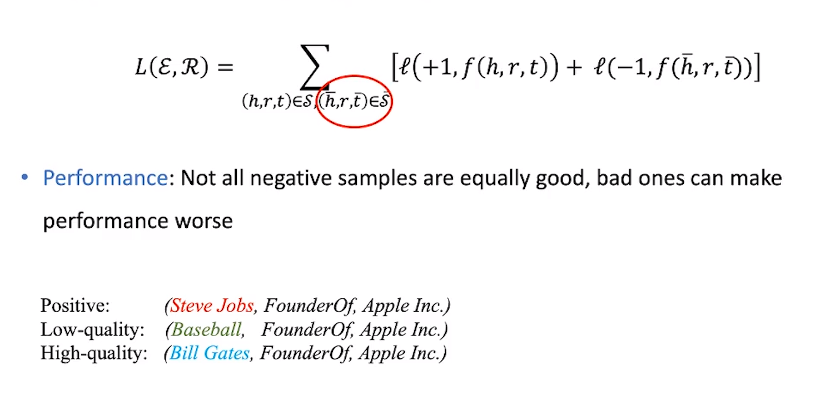
WHY Negative Sampling

Slide 8
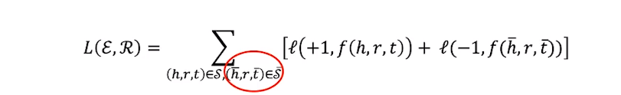
WHY Negative Sampling
Leveraging contrastive estimation to train KG embedding models involves optimizing the model by pushing up the energy with respect to observed positive triplets while simultaneously pushing down energy on negative triplets.
训练KGE, 就是要负采样识别出容易识别的score低的负样本—因为这些样本不提供负梯度
Computation: number of negative samples is very large, considering all of them is computationally infeasible.
对于给定n个node, 共有（n^2）/2条边，所以non-observed triplets数量是很大的。

Slide 9
Related Work
进行负采样的方式：
Uniform or Bernoulli (FIXED)
negative triplets can be generated using a uniform sampling scheme. However, such uniform and fixed sampling schemes result in easily-classified negative triplets during training, which do not provide any meaningful information .Hence, as the training progresses, most of the sampled negative triplets receive small scores and almost zero gradients, impeding the training of the graph embedding model after only a small number of iterations.
NON-FIXED
Self-Adversarial --- (computationally expensive)
GAN-based --- expensive to train and black-box gradient estimation
Nscaching --- not considered the graph structure.

Slide 10
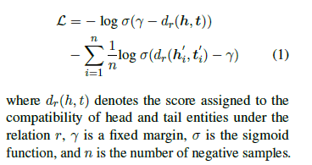
Structure Aware Negative Sampling
Loss function:
n: is not the number of all entity, so NS is a kind of approximation

Slide 11
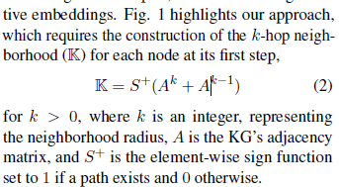
Why Structure awared?
we hypothesize that enriching the negative sampling process with structural information can yield harder negative examples, crucial to learning effective embeddings.
What is the approach?

Slide 12
Variants of SANS
Although SANS requires a one-time preprocessing step to construct K as defined in Eqn. 2, this may still be costly for large and dense KGs.
用Random Walk 来代替邻接矩阵计算。
k-hop random walk approximate the length k in the adjacency tensor.
2. 结合了SOAT 方法 建立了 self-adversarial SANS，-结合Scoring Function的权重
负采样loss=-log\sig(y-dr(h,t))-\Sum\sig{p(h',r,t')*(dr(h',t')-y)}
其中p(h',r,t')=softmax(a*dr(h,t))

Slide 13
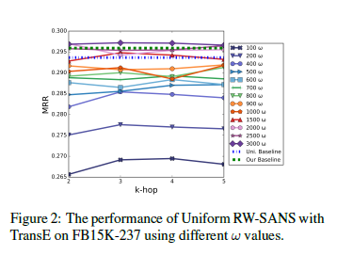
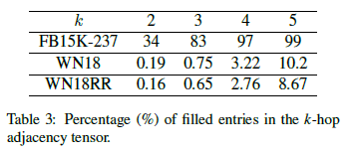
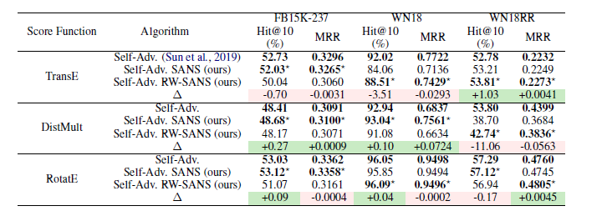
Results
we find that the k-hop tensor can not only be
well approximated with 3000 random walks, but
RW-SANS beats both baselines. We reconcile this
result by noting that certain nodes have a higher
probability of being sampled due to sharing a larger
number of paths with the center node, resulting in
an implicit weighted negative sampling scheme.
Notes:
太多的filled entity连接让邻接矩阵更加精准对关系进行刻画，而random walk效果不佳

Slide 14
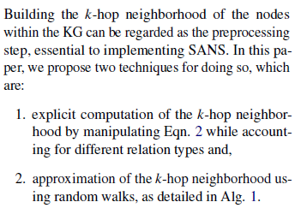
Preprocessing

Slide 15
